Slide 1
Traces of Low German Influence on Finnish in the Middle Ages
Mikko Bentlin
University of Greifswald, Germany
mikko.bentlin@uni-greifswald.de

Slide 2
Moi!

Slide 3
Finland in the 12th Century
Politics: Incorporation into the Swedish realm
Religion: Christianization from both East and West
Economy: Beginning domination of the Hanseatic League around the whole Baltic Sea, combined with German eastward expansion on the Southern and Eastern shores
Finns came into contact with Low-German speakers on all these areas of life
Notes:
Political and religious factors broke up the Northern Baltic-Finnic dialect continuum

Slide 4
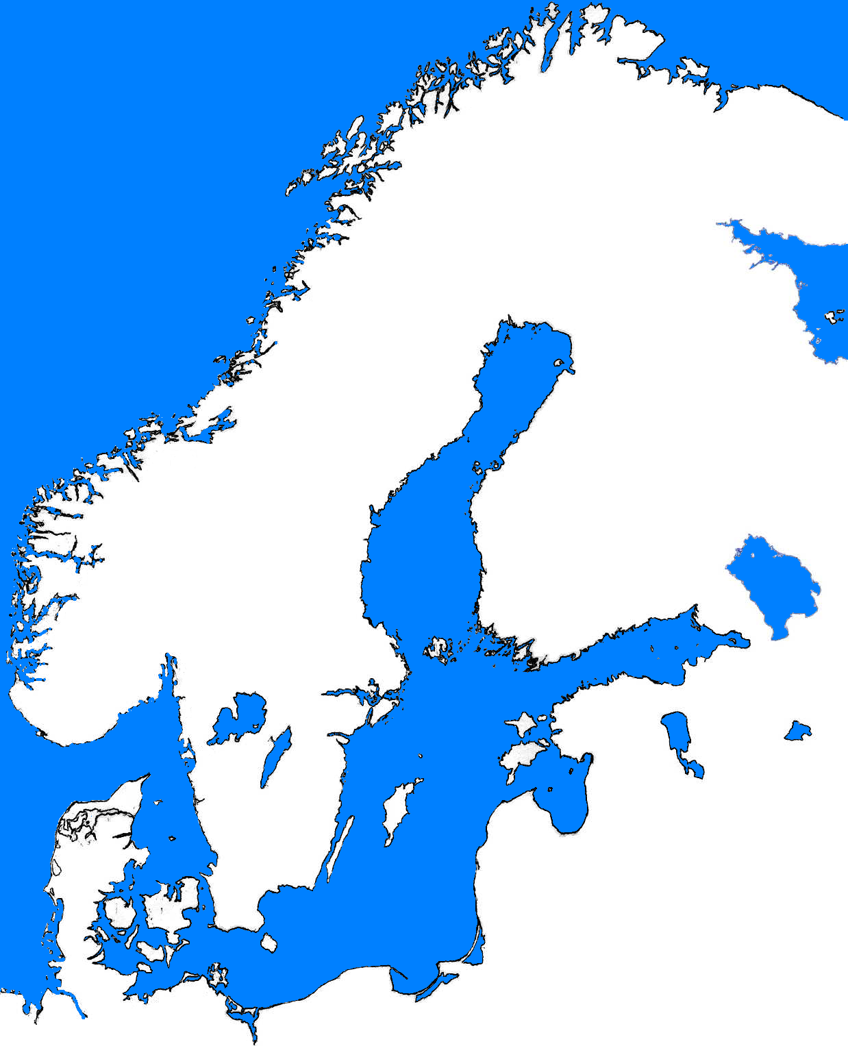
Swedish
Norwegian
Finnish
Russian
Estonian
•Visby
Livonian
Denish
Latvian
•
Lübeck
Notes:
Lübeck was the dominating city of the Hanseatic League during many centuries, while Visby in Gotland was one of its birthplaces and centre of Baltic trade

Slide 5
Chronology of Low German
Separate language within the West Germanic branch of Germanic, Fi. alasaksa, Germ. Niederdeutsch
Old Saxon = Old Low German about 800–1150/1200 AD, had great similarities with Old Dutch, being at the same time rather different from Old High German.
Gap in documentation between appr. 1150 and 1250
Middle Low German about 1250–1600, always under pressure from the more prestigious High German
Notes:
Fi. Saksa from the ethnonym of Saxons!

Slide 6
Chronology of Low German (2)
Reformation and Luther‘s Bible translation speeded up the decline of Low German as a literary language
In the Baltics, the use of Low German ended quite rapidly because there were almost no native speakers in the numerally larger lower classes and thus no relevant dialectal basis for further development
Even in areas with Low German-speaking majorities, the language lost its position as written standard.
Notes:
Bugenhagen‘s Bible translation came quite at the same time as Luther‘s High German one, but remained one of the few printed books in classical Middle Low German.

Slide 7
Swedish or Low German?
A great part of the Swedish lexicon is of Low German origin
Swedish was the language of administration and dominated up to the 20th century
Influence from both Standard Swedish and Swedish dialects spoken in Finland
Low German was the dominanat language in economic affairs
The institution of the city was introduced according to German models and until 1471 Germans were supposed to hold half of the posts in city councils and mayors‘ offices
Notes:
Native Finns who wanted to make their way up had to choose at least one foreign language for their career: Swedish for administration, Latin for religious offices, Low German for economical careers.

Slide 8
Possible distinction criteria
1. Phonetical criteria:
Difficult, because most possible Swedish and Low German originals are more or less identical
Remarkable exception: Sequence /ouv/ (e.g. in rouva 'lady', touvi 'rope') points to Low German origin
Germanic feminine nouns ending in a vowel that has been replaced by Fi. -u/-y e.g. Fi. lykky 'luck' as Swedish retained -o/-u in oblique cases much longer than Low German
Notes:
One of the earliest voices in favour of the existence of Low German loan words was T. E. Karsten who formulated the problem as follows in 1909:
„Da die Finnen, wie bekannt, während aller Perioden einen großen Teil ihrer höheren Kulturbegriffe von den Schweden gelernt und gleichzeitig die dafür gebrauchten Ausdrücke entlehnt haben, ergibt sich hieraus a priori, daß wir unter den schwedischen Lehnwörtern im Finnischen auch niederdeutsches Sprachgut zu erwarten haben. Durch die oben skizzierten direkten Beziehungen der Finnen zu Deutschland sind die niederdeutschen Bestandteile im Finnischen wahrscheinlich vermehrt worden. In welchem Grade, ist aber nicht mehr sicher zu erschließen.“
„As it is known, the Finns have during all periods learnt a great part of higher cultural concepts from the Swedes and at the same time they have borrowed the necessary words. The outcome of this is a priori, that we have to expect there to be Low German linguistic material among the Swedish loanwords as well. The number of Low German elements in Finnish has probably increased by the direct contacts described above. However, it is no longer possible to estimate to what extent this has been the case.“
Therefore Karsten did not even try to distinguish between direct and indirect borrowings. Karsten‘s explanations about the word rouva in 1909 have often been misinterpreted as a Low German etymology while he actually only pointed out that there might be some kind of connection between the Low German and Finnish words. As a consequence, rouva was for a long time the only widely accepted Low German loanword (and one of the few etymologies by its author that was accepted among Finnish linguists).

Slide 9
Possible distinction criteria
2.) Semantic criteria
Non-existence of a word in either Low German or Swedish:
E.g. Fi. dial. laatta 'sand bank' should be of Low German origin, while laatta 'plate' can be borrowed from either Swedish or Low German

Slide 10
Possible distinction criteria
Most Low German borrowings in the fields of
a) Church and Christian religion (kirkko 'church', rauha 'peace', ?sielu 'soul')
b) Fishery (monni 'wels catfish, silurus glanis', rysä 'fish trap')
c) Craft, trade and urban life (ammatti 'profession', rouva 'lady', räätäli 'tailor')

Slide 11
Possible distinction criteria
3.) Distributional criteria
Most obvious Low German loans are found in South Eastern dialects that historically belonged to the economical hinterland of the city Vyborg (Viipuri).
Another gate into Finland may have been the valley of the River Kokemäenjoki where some words of Low German origin must have lived for centuries without spreading into other Finnish dialects. (e.g. asikko 'small salmon or trout', katve 'shadow')

Slide 12
Conclusion
Low German loanwords in Finnish open quite a new perspective on cross-cultural contacts in the Baltic Sea area as well as the history of both languages.
Low German loanwords in Finnish cover a wide range of medieval everyday life. Borrowed conjunctions and particles such as entä and vaan seem to have had some structural influence on Finnish.
Low German loanwords are obviously more numerous than than e.g. the more widely known Indo-Iranian loanword layer in Finnish.
Notes:
This information has a great value for historians and archaeologists as well.

